Slide 1
Lecture 0.3.O.1.
A Liberal Education
J. Bradford Delong
http://bradford-delong.com
brad.delong@gmail.com
@delong
2020-05-17 last updated
key: <https://www.icloud.com/keynote/0nINl20q2hWRDnARhzSkxfbWw>
github: <https://github.com/braddelong/public-files/blob/master/lecture-optional-liberal-education.pptx>
html: <http://www.bradford-delong.com/2018/06/lecture-a-liberal-education.html>

Slide 2
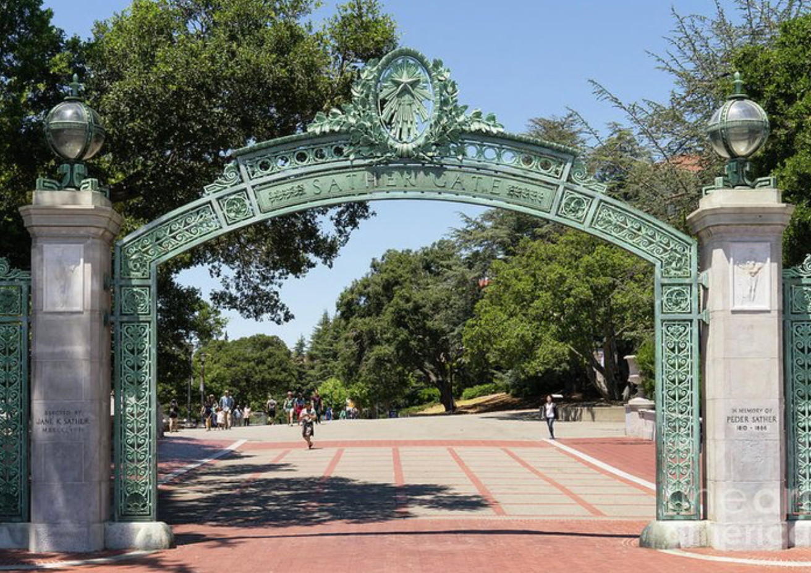

Lecture 0.3.O.1. A Word or Two on a Liberal Education
This is an investment by you in you:
A “liberal education”
Surprise benefits
The value to you of a liberal education
This is an investment by the state of California:
The value to us of your getting a liberal education
This is an investment by the human race:
The value to us of your getting a liberal education
This carries not just privileges and immunities, but responsibilities and obligations

Slide 3
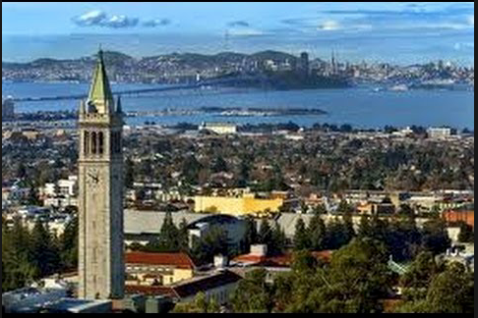
This Is Berkeley!

Slide 4
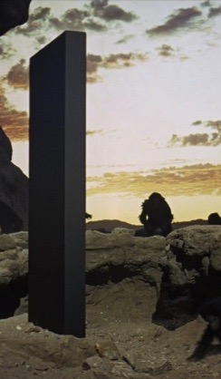
You Are Lucky to Be Here
This is the University of California at Berkeley
Certainly the finest public university in the world
Perhaps the finest university in the world
Lots of opportunities here
Others could be in your seats
They would take advantage of the opportunities here
DON’T WASTE YOUR OPPORTUNITY HERE!!

Slide 5
You Belong Here
We go fast here
We want to teach you a lot of stuff
You can—and should—handle it
We are confident you belong here—can take advantage of the opportunities
We are rarely wrong

Slide 6
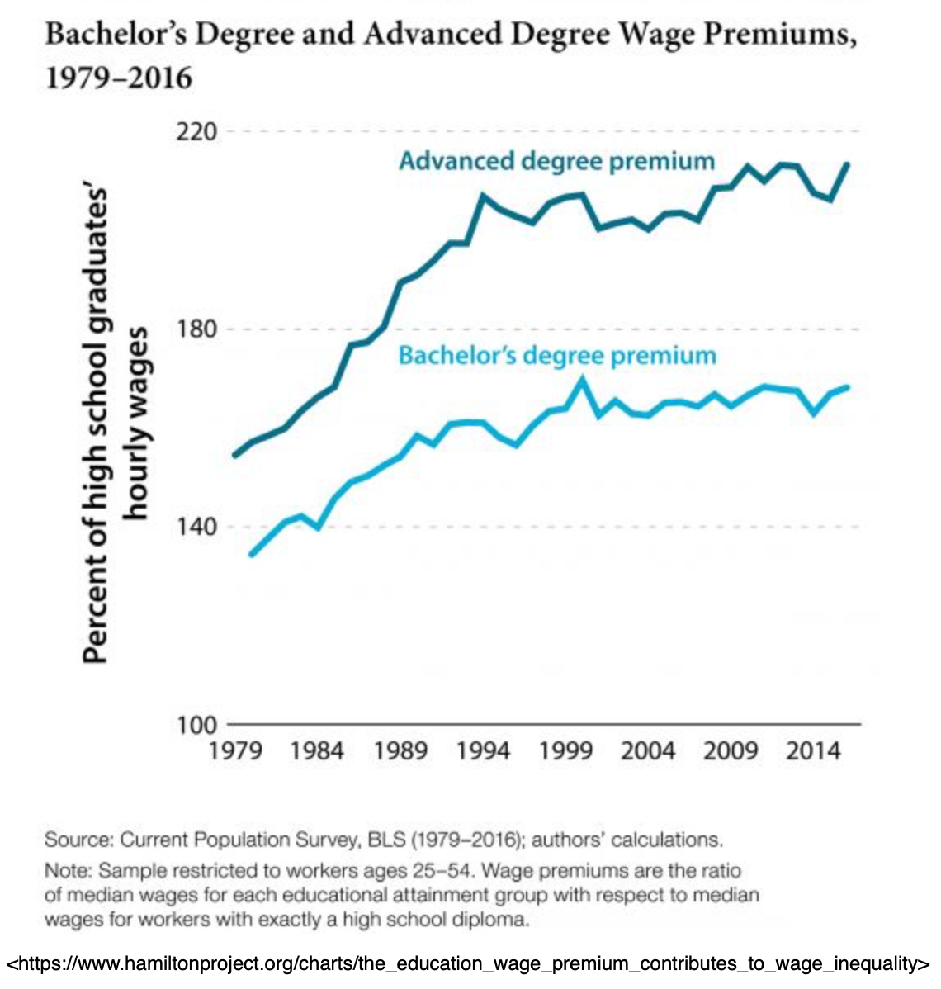
What Is a “Liberal Education”?
“Liberal education” ≠ “kinda left-wing education” here
“Liberal education” here means “appropriate to somebody free”
Someone with control over their own destiny
Someone with a share of control over our common destinies
Not a serf, not a cleric, but also not a vassal—not somebody embedded in the system in a fixed place…

Slide 7
What Is a “Liberal Education”? II
Someone with control over their own and a share of control over our common destinies
Not someone taught a particular skill to do one thing
But, rather, someone whose life will be spent in a wide range of activities
And who thus needs a wide range of knowledge

Slide 8
Privileges and Immunities
A liberal education is a very valuable thing
65% x $40,000 = $26,000/year
What alternative $200,000 investment gets you 10%/year as a real return?
If you graduate…
Plus: freedom, depth of experience…

Slide 9
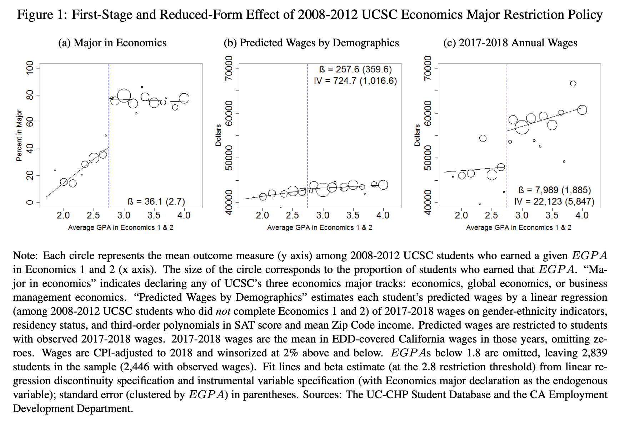
Is This Selection—or Signalling? No. One Example Study
UCSC required a 2.8 in Econ 1 & 2 to major back in 2008-12:
This is a regression discontinuity study
If you got a 2.7 average, you argued your way into the econ major with 37% probability.
If you got a 3.0, you majored in econ with 80% probability
The wages of those with 3.0 are today higher than the wages of those with 2.7 by $10,000/year
10000/(.80-.37) = $23,250/year
Zachary Bleemer and Aashish Mehta <http://zacharybleemer.com/wp-content/uploads/2020/04/Return_to_Economics.pdf>

Slide 10

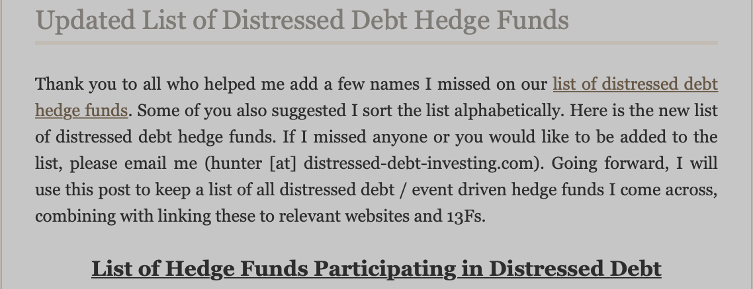
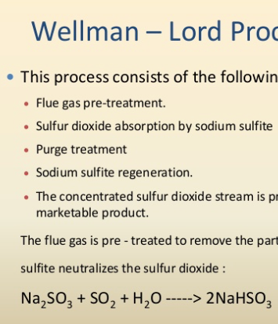

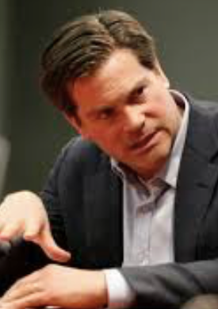
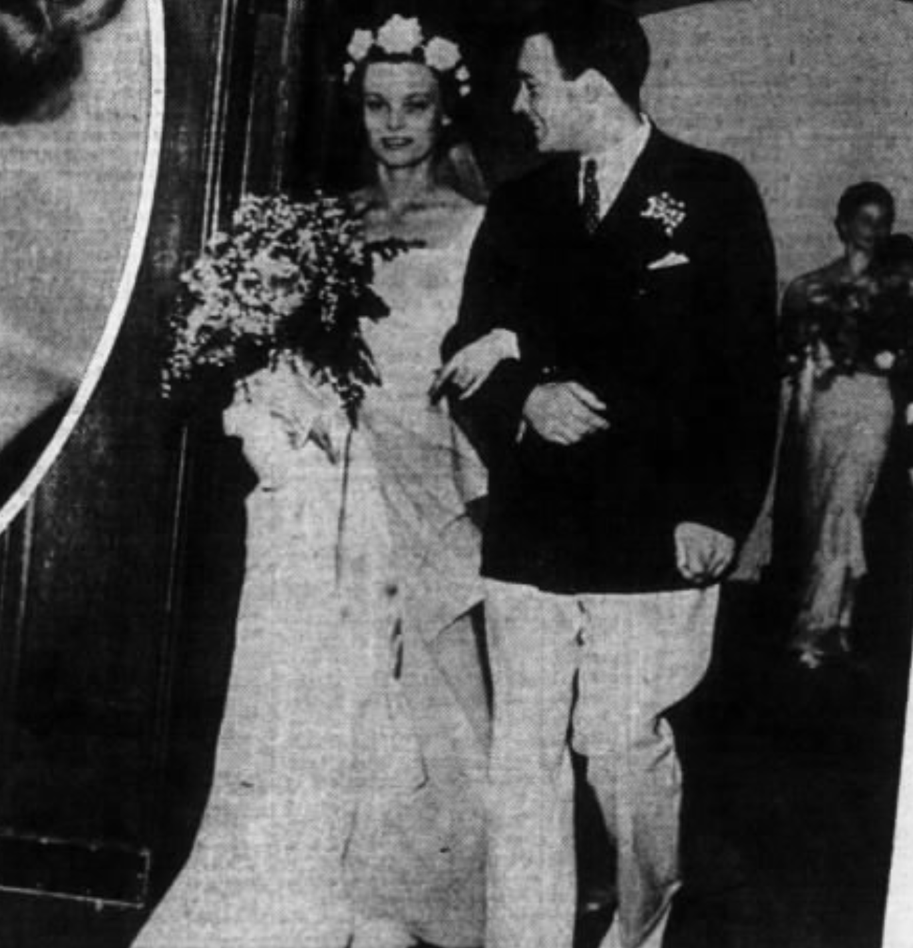
It is Not the “Technical” Training That Is the Most Valuable
In my extended family, three people who were, are, or look like they are headed not for the top 1% but the top 0.1%…
construction and chemical engineering—ultimately pollution control—“smart money” on Wall Street managing the flow of financing of investment, “the industry” as they call it in LA…
Learning how to deal socially as an outsider at Harvard in the 1920s, historical source analysis in the 1980s, messing around in Dartmouth AV in the 1990s

Slide 11
It is Not the “Technical” Training That Is the Most Valuable
What was valuable?:
learning how to deal socially as a (relative) outsider at Harvard in the 1920s,
historical-critical source analysis in the 1980s,
messing around with Dartmouth AV in the 1990s

Slide 12
Learning Goals: Economic Literacy
The real learning goal for this course is: economic literacy.
At the end of the course, students should be able to take any article about the economy, whether in, say, the Financial Times or the Economist or the San Francisco Chronicle or Business Insider or vox.com:
Determine what assertions it is making about
how the economy works, and
what the current state of the economy is;
break down those assertions;
use economic logic and economic models and economic data to analyze them; and
conclude whether, and under what conditions, the arguments made make sense.

Slide 13
Applied to Understand Our Economic History
What will professors teach 2000 years from now?
All of our history will be “ancient history”
They will focus on the long 20th century
Between:
the appearance of the iron-hulled oceangoing steamship, the submarine telegraph cable, and the industrial research lab around 1870
the business cycle collapse followed by the anemic recovery of 2007-2015
More changed, and more things that were important changed than in any other century so far

Slide 14
Applied to Understand the Economy
What should we teach you here and now?
Center of gravity of your careers and influence will be 2050 or so
Want you to be:
Good citizens
Good partners in “commerce” and “congress”—broadly understood
How the economy works:
How it is built upon gift-exchange, trust, and sociology
How markets work
How markets fail
How bureaucracies fit in

Slide 15
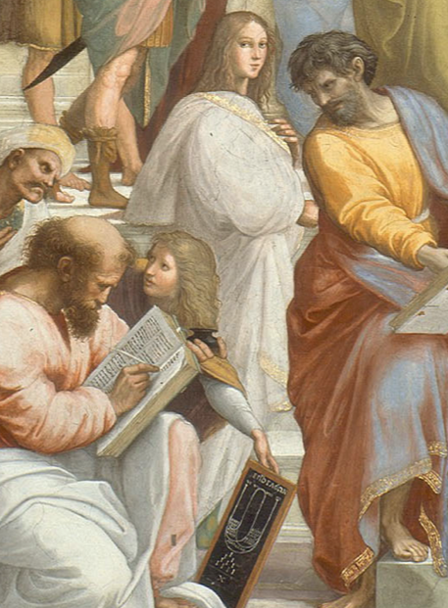
So Learn!: Extend Your Brains in Every Direction Your Curiosity Moves You
References in this lecture you may not be familiar with:
“Avicenna”: Peter Beagle (1987): The Folk of the Air <http://amzn.to/1PvCcdN>.
Ibn Sina: Abū ʿAlī al-Ḥusayn ibn ʿAbd Allāh ibn Al-Hasan ibn Ali ibn Sīnā <http://tinyurl.com/n58rjc6>
“State of Euphoria”: David Lodge (1975): Changing Places <http://amzn.to/1nhoXXp>.
Enkidu: Gilgamesh <http://amzn.to/1PepdkP>.
Fujiwara Takako: Genji Monogatari <http://amzn.to/1nhCkXy>.
Hypatia <http://tinyurl.com/z9uyqy>:
Ibn Khaldun: Abū Zayd ‘Abd ar-Raḥmān ibn Muḥammad ibn Khaldūn al-Ḥaḍramī, Muquaddimah <http://amzn.to/1Sd0uhv>.
Odysseus: <http://amzn.to/1nhCA94>.

Slide 16
Catch Our Breath…
What’s up next?
Comments?
Questions?

